Slide 1

FDA Approves Zyn for Modified Risk
REGULATORY & PUBLIC HEALTH BRIEFING
The first nicotine pouches cleared to be marketed as lower-risk than cigarettes — and the health debate it set off.
June 30, 2026

Slide 2

What the FDA Decided
THE DECISION · JUNE 30, 2026
20 ZYN products authorized
10 flavors, each in 3 mg and 6 mg nicotine strengths.
A first for nicotine pouches
The first modified-risk orders the FDA has ever granted for a pouch product.
Made by Swedish Match / PMI
Cleared after a multi-year scientific review and a January 2026 advisory panel.
THE AUTHORIZED CLAIM “Using ZYN instead of cigarettes puts you at a lower risk of mouth cancer, heart disease, lung cancer, stroke, emphysema, and chronic bronchitis.”
FDA Modified-Risk Authorization · ZYN Nicotine Pouches
2

Slide 3
What Critics Warn
PUBLIC HEALTH CONCERNS
Health groups say lower risk is not no risk — and worry the move normalizes nicotine.
“Smokeless doesn't mean harmless”
The American Lung Association called the decision appalling, noting nicotine still carries real health risks.
Nicotine is highly addictive
At up to 6 mg per pouch, strengths exceed nicotine gum — deepening dependence, researchers caution.
Most users don't quit — they add
Evidence shows many use pouches alongside cigarettes rather than switching, blunting the health benefit.
Risk of normalizing nicotine
Flavors, workplace use, and social media could draw in people who never smoked, including youth.
FDA Modified-Risk Authorization · ZYN Nicotine Pouches
4

Slide 4
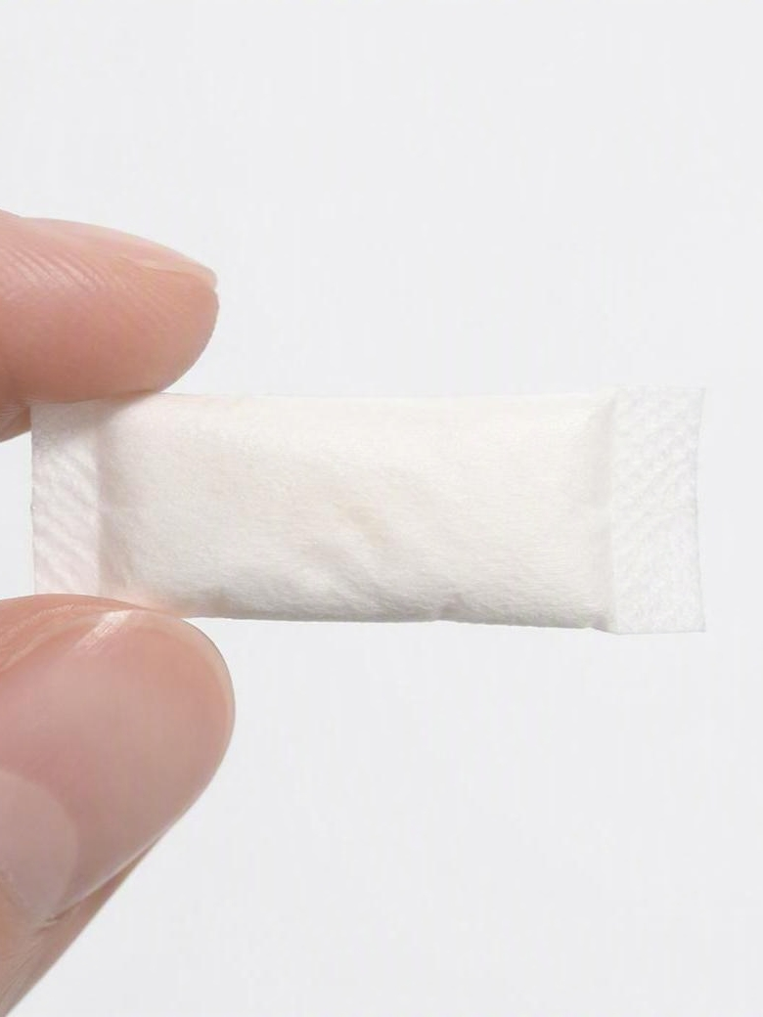
The Bottom Line
WHERE THINGS STAND
A landmark decision that turns on one word: switching.
For adult smokers
It offers FDA-backed, science-based information to choose a lower-risk alternative to cigarettes.
The open question
Benefits hold only with full switching — dual use or uptake by non-smokers could erode the gains.
What comes next
The orders run five years with ongoing surveillance the FDA can revisit if real-world use shifts.
FDA Modified-Risk Authorization · ZYN Nicotine Pouches
5

